Slide 1

Capstone Project
(CoolTShirts.com)
Learn SQL from Scratch
Masis Geragosian
March 2019

Slide 2
Table of Contents
1.Get familiar with CoolTShirts
2.What is the user journey?
3.Optimize the campaign budget

Slide 3
1. Get Familiar With CoolTShirts

Slide 4
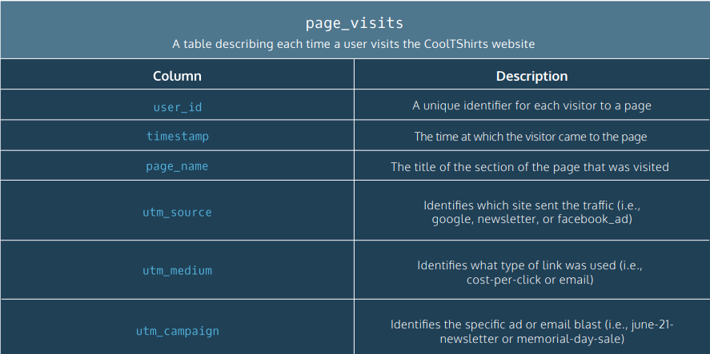
The Web Schema for CoolTShirts.com

Slide 5
Campaign vs. Source
Campaign
Specific promotional sales or strategies that are promoted on one or multiple sources
Source
Identifies sites that a promotional campaign was promoted on, and the traffic was originated from

Slide 6
Get Familiar With CoolTShirts
There are 8 distinct campaigns including
getting-to-know-cool-tshirts
weekly-newsletter
ten-crazy-cool-tshirts-facts
retargetting-campaign
retargetting-ad
interview-with-cool-tshirts-founde
paid-search
cool-tshirts-search
There are 6 distinct sources including
Nytimes
Email
Buzzfeed
Facebook
Medium
Google
SELECT COUNT(DISTINCT utm_campaign)
FROM page_visits;
SELECT COUNT(DISTINCT utm_Source)
FROM page_visits;

Slide 7
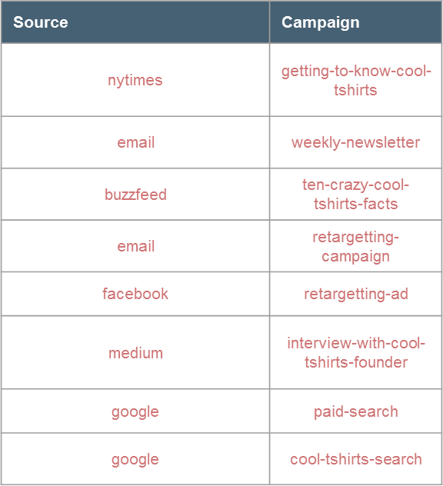
Campaign Vs. Source (Relationship)
type 3
SELECT DINSTINCT utm_Source,
utm_campaign
FROM page_visits;

Slide 8
Get Familiar With CoolTShirts (Cont.)
CoolTShirts website has following four pages
SELECT DISTINCT page_name
FROM page_visits;
1 - landing_page
2 - shopping_cart
3 - checkout
4 - purchase

Slide 9
2. What is the user journey?

Slide 10
User Journey (First Touch)
First touch attribution identifies how the users or visitors are initially discovering the website. In case of the first touch, the highest contribution for a campaign goes to interview-with-cool-tshirts-founder. Other major campaign contributors to first touch attribution are as follow
WITH First_touch AS (
SELECT user_id,
MIN(timestamp) AS first_touch_at
FROM page_visits
GROUP BY user_id)
SELECT ft.user_id,
ft.first_touch_at,
pv.utm_source,
pv.utm_campaign,
COUNT(utm_campaign)
FROM first_touch ft
JOIN page_visits pv
ON ft.user_id = pv.user_id
AND ft.first_touch_at = pv.timestamp
GROUP BY utm_campaign;
user_id | first_touch_at | utm_source | utm_campaign | Count(utm_campaign)
99990 | 2018-01-13 23:30:09 | medium | interview-with-cool-tshirts-founder | 622
99933 | 2018-01-25 00:04:39 | nytimes | getting-to-know-cool-tshirts | 612
99765 | 2018-01-04 05:59:46 | buzzfeed | ten-crazy-cool-tshirts-facts | 576
99684 | 2018-01-13 13:20:49 | google | cool-tshirts-search | 169

Slide 11
User Journey (Last Touch)
Last touch attribution shows how many times each campaign draws visitors back to the website. Following table shows all the campaigns and the numbers of times they draw visitors back to the website
WITH last_touch AS (
SELECT user_id,
MAX(timestamp)AS last_touch_at
FROM page_visits
GROUP BY user_id)
SELECT lt.user_id,
lt.last_touch_at,
pv.utm_source,
pv.utm_campaign,
COUNT(utm_campaign)
FROM last_touch lt
JOIN page_visits pv
ON lt.user_id = pv.user_id
AND lt.last_touch_at = pv.timestamp
GROUP BY utm_campaign;
user_id | last_touch_at | utm_source | utm_campaign | Count(utm_campaign)
99344 | 2018-01-18 21:36:32 | google | cool-tshirts-search | 60
99589 | 2018-01-15 04:55:43 | nytimes | getting-to-know-cool-tshirts | 232
99838 | 2018-01-02 07:40:34 | medium | interview-with-cool-tshirts-founder | 184
98840 | 2018-01-10 04:58:48 | google | paid-search | 178
99928 | 2018-01-24 05:26:09 | facebook | retargetting-ad | 443
99990 | 2018-01-16 11:35:09 | email | retargetting-campaign | 245
99765 | 2018-01-04 05:59:47 | buzzfeed | ten-crazy-cool-tshirts-facts | 190
99933 | 2018-01-26 06:18:39 | email | weekly-newsletter | 447

Slide 12
User Journey (Paid Customers)
There were total of 361 purchases made on the website
SELECT COUNT(DISTINCT user_id)
FROM page_visits
WHERE page_name = ('4 - purchase');

Slide 13
User Journey (Paid Customers)
There were a total of 361 purchases made and following campaigns are the contributors for those purchases
WITH last_touch AS (
SELECT user_id,
MAX(timestamp) AS last_touch_at
FROM page_visits
WHERE page_name = '4 - purchase'
GROUP BY user_id)
SELECT lt.user_id,
lt.last_touch_at,
pv.utm_source,
pv.utm_campaign,
COUNT(utm_campaign)
FROM last_touch lt
JOIN page_visits pv
ON lt.user_id = pv.user_id
AND lt.last_touch_at = pv.timestamp
Group By utm_campaign;
user_id | last_touch_at | utm_source | utm_campaign | Count (utm_campaign)
99933 | 2018-01-26 06:18:39 | email | weekly-newsletter | 115
99897 | 2018-01-06 09:41:19 | facebook | retargetting-ad | 113
99285 | 2018-01-24 09:00:58 | email | retargetting-campaign | 54
94567 | 2018-01-19 16:37:58 | google | paid-search | 52
92172 | 2018-01-16 15:15:29 | nytimes | getting-to-know-cool-tshirts | 9
98651 | 2018-01-15 04:17:36 | buzzfeed | ten-crazy-cool-tshirts-facts | 9
83547 | 2018-01-10 18:20:21 | medium | interview-with-cool-tshirts-founder | 7
95650 | 2018-01-18 00:25:00 | google | cool-tshirts-search | 2

Slide 14
AA User’s Journey
A typical user journey starts with initial discovery of the website AKA “ First Touch”. This is where visitors come to the website for the first time, using sources such as medium, NY time, and buzz feed, and through campaigns such as interview with cool t-shirts founder, getting to know cool t-shirts, and ten crazy cool t-shirts facts.
During the initial visit, some visitors make a purchase and some don’t. However, some visitors who did not make a purchase during the initial visit, would have drawn back to the site. This revisit is called “Last Touch” in which some visitors make their purchase. Retargeting ads, weekly newsletter and getting to know cool t-shirts, are best campaigns to draw users back to the website. On the other hand, email, Facebook, and NY times are the best sources for the last touch.
Finally, using email with weekly-newsletter campaign and Facebook with retargeting ad produces the highest purchase rate.

Slide 15
3. Optimize the campaign budget

Slide 16
3. Optimize the campaign budget
By looking at top 5 campaigns where the customers made a purchase, we would see that following campaigns are the most effective. Meanwhile, it might be even better idea to spend more money on weekly-newsletter and retargetting-ad(s) since their rate of return is twice as much as other campaigns
WITH last_touch AS (
SELECT user_id,
MAX(timestamp) as last_touch_at
FROM page_visits
Where page_name = '4 - purchase'
GROUP BY user_id)
SELECT lt.user_id,
lt.last_touch_at,
pv.utm_source,
pv.utm_campaign,
COUNT (utm_campaign)
FROM last_touch lt
JOIN page_visits pv
ON lt.user_id = pv.user_id
AND lt.last_touch_at = pv.timestamp
Group By utm_campaign
Order BY 5 desc;
user_id | last_touch_at | utm_source | utm_campaign | Count (utm_campaign)
99933 | 2018-01-26 06:18:39 | email | weekly-newsletter | 115
99897 | 2018-01-06 09:41:19 | facebook | retargetting-ad | 113
99285 | 2018-01-24 09:00:58 | email | retargetting-campaign | 54
94567 | 2018-01-19 16:37:58 | google | paid-search | 52
92172 | 2018-01-16 15:15:29 | nytimes | getting-to-know-cool-tshirts | 9
98651 | 2018-01-15 04:17:36 | buzzfeed | ten-crazy-cool-tshirts-facts | 9

